Slide 1




Centre for Technology Alternatives for Rural Areas
Indian Institute of Technology Bombay
Big Data tools for monitoring the impact of
IWMP-MGNREGS projects under DISHA Dashboard
Master’s Thesis Project-2 Mid-progress Presentation
Guided by,
Prof. Pennan Chinnasamy
Examiners
Prof. N.C. Narayanan Prof. Satish B. Agnihotri
Presented by,
Shivanand Nalgire (193350009)

Slide 2


Content
Introduction
Objectives
Project timeline
Model development
Land Surface Ecological status and monitoring
RS based Land Surface Ecological Indicators
Temporal analysis
Weight generation methods
Principal Component Analysis
Model summary
Results and discussions

Slide 3
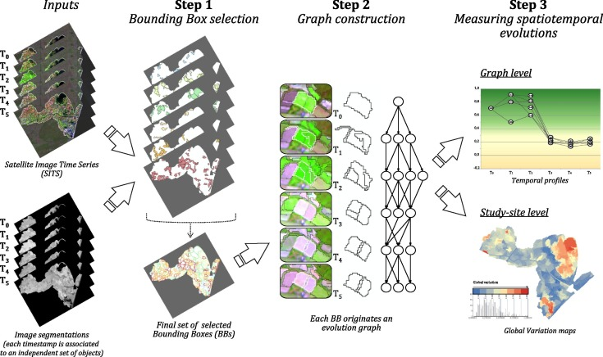

Introduction
Introduction
Model development
RS Data analysis
Model summary
Results and discussions
DISHA Dashboard – System for M&E of schemes
Enables data driven governance of 43 schemes
Monitor impacts of IWMP-MGNREGS projects
Index based M&E framework
Open source remote sensing data
Illustrative image for RS data analysis Source: (Belgiu and Csillik., 2018)

Slide 4
Objectives
Introduction
Model development
RS Data analysis
Model summary
Results and discussions
To develop an index based multidimensional M&E framework for assessing the impact of IWMP-MGNREGS projects
To analyze the data using M&E framework and validate the model using secondary data
To develop a web application for automated near-real time monitoring and reporting of the impact of IWMP-MGNREGS projects

Slide 5




Project timeline and progress
Introduction
Model development
RS Data analysis
Model summary
Results and discussions
Oct-Nov 2020
Dec
2020
Jan
2021
February
2021
March- April
2021
Mapping & Data Analysis using model
Secondary data analysis &
model validation
Web Dashboard & Documentation
Model update
M&E of IWMP using RSEI
Weightage of indices
Developing remote sensing data pipeline
Secondary data analysis for model validation
M&E of IWMP projects
Dashboard design
Model update
Analyzing data using developed model
Model improvement
Scaling model at Maharashtra level
Protocol for using the M&E framework

Slide 6
Ecological status and monitoring
Introduction
Model development
RS Data analysis
Model summary
Results and discussions
IWMP-NRM:
Enhance soil moisture regime
Regenerate natural vegetation
Increase productive land, production and productivity
Termed as Ecological Status of Land Surfaces (Kennedy et al., 2009; Xu et al., 2019)
Assessed by Ecological Monitoring of Land Surfaces (Willis, 2015)
Using Land Surface Ecological Indicators (Jones et al., 2009)

Slide 7
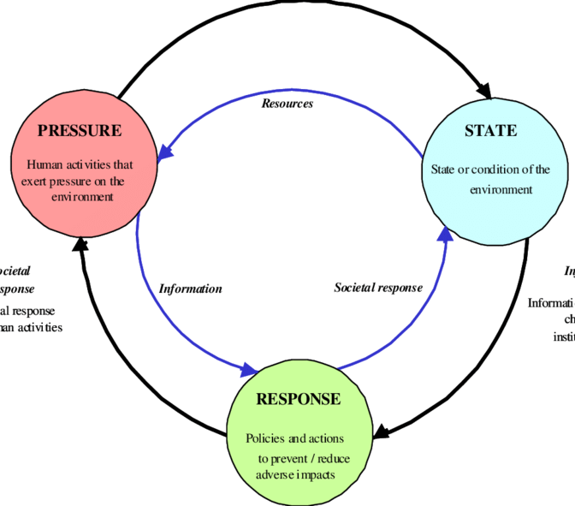
Land Surface Ecological Indicators
Introduction
Model development
RS Data analysis
Model summary
Results and discussions
Indicators derived from System Dynamics framework – ‘Pressure State Response’ framework (Friend and Rapport., 1979) based on notion of causality (Hughey et al., 2004)
Ecological changes → significant alteration in characteristics of land surfaces (Willis, 2015)
Ecological indicators of these characteristics are – Moisture, Greenness, Dryness, Heat (Xu et al., 2019)
IWMP-MGNREGS Projects
Ecological status
Change in production, crop area

Slide 8
RS based Land Surface Ecological Indicators
Introduction
Model development
RS Data analysis
Model summary
Results and discussions
Any ecological changes will have a significant alteration in important characteristics of land surfaces. (Willis, 2015; Xu et al., 2019)
Notion
$$RSEI=f\left(Moisture, Greenness, Dryness, Heat\right)$$

Slide 9
Weight generation for composite index
Introduction
Model development
RS Data analysis
Model summary
Results and discussions
Sr. No. | Types of index weight determination methods | Method | Remark | Citation for remark
1 | Subjective methods | AHP / Delphi | 1) Subjective judgement may affect weight distribution in practice 2) Limited by large sample size 3) Less scalable and resilient | 1) (Xu et al., 2018) 2) (Liao and Jiang, 2020)
2 | Objective methods | PCA | 1) Superior for evaluation of multidimensional indexes 2) Resilient against the impact of co-linearity 3) Automatic and objective weight allocation 4) More scalable | 1) (Xu et al., 2019) 2) (Hu and Xu, 2019) 3) (Gau and Zhao, 2020) 4) (Xu et al., 2018) 5) (Liao and Jiang, 2020) 6) (Hu and Xu, 2018)

Slide 10
Worldwide practices of RSEI
Introduction
Model development
RS Data analysis
Model summary
Results and discussions
Sr. No. | Paper | Authors | RSEI Indices used | Aggregation/weighing technique
1 | Detecting Ecological Changes with a Remote Sensing Based Ecological Index (RSEI) Produced Time Series and Change Vector Analysis | (Xu et al., 2019) | NDVI, IBI | Principal Component Analysis (PCA)
2 | A new remote sensing index for assessing the spatial heterogeneity in urban ecological quality: A case from Fuzhou City, China | (Hu and Xu, 2018) | NDVI, NDBSI, LSM, LST,IBI, SI | Principal Component Analysis (PCA)
3 | A new remote sensing index based on the pressure-state-response framework to assess regional ecological change | (Hu and Xu, 2019) | NDBSI, NDVI | Principal Component Analysis (PCA)
4 | Eco-Environmental Quality Monitoring in Beijing, China, Using an RSEI-Based Approach Combined With Random Forest Algorithms | (Gou and Zhao, 2020) | NDVI; NDBSI; LST | Principal Component Analysis (PCA)
5 | A remote sensing index for assessment of regional ecological changes. | (HanQiu, 2013) | - | Principal Component Analysis (PCA)
6 | Prediction of ecological effects of potential population and impervious surface increases using a remote sensing based ecological index (RSEI) | (Xu et al., 2018) | NDVI, LST, NDSI | Principal Component Analysis (PCA)
7 | Evaluation of the Spatiotemporal Variations in the Eco-environmental Quality in China Based on the Remote Sensing Ecological Index | (Liao and Jiang, 2020) | NDVI, NDBI, NDWI | Delphi Method, AHP, PCA

Slide 11
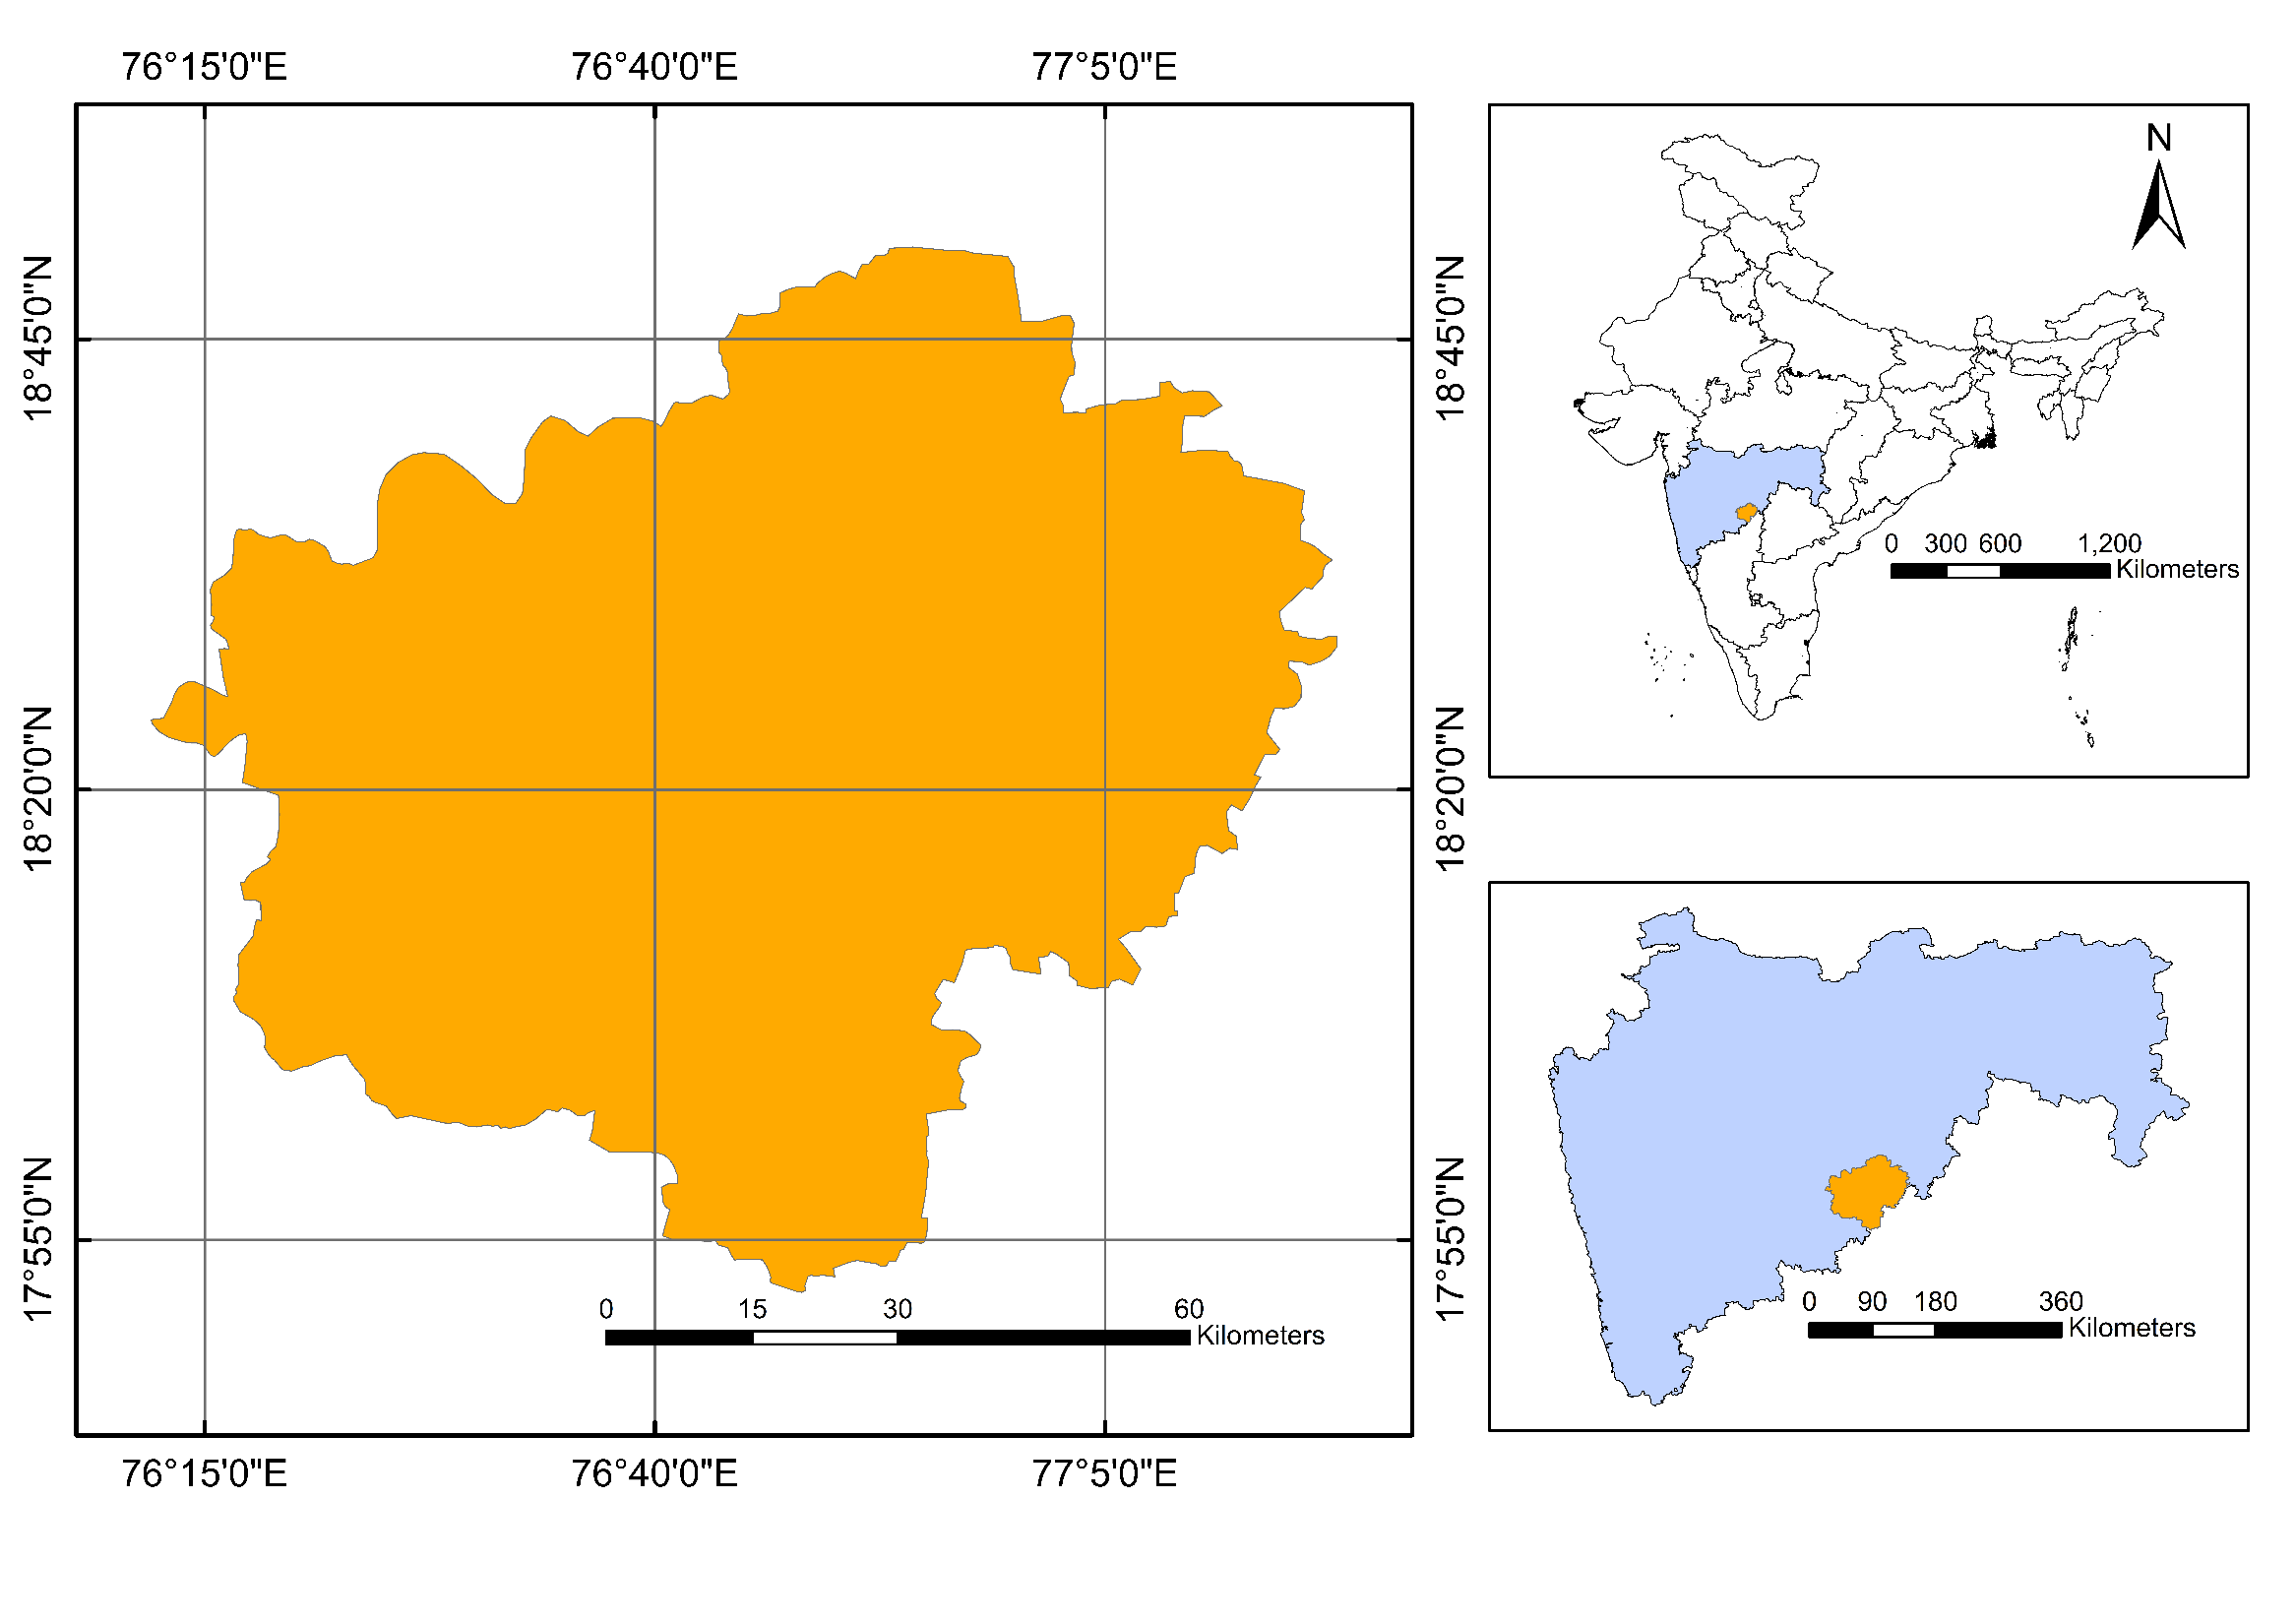
Study Area
242 out of 1,344 IWMP watersheds i.e. highest are in Maharashtra
Latur district as pilot project
Model validation with secondary data

Slide 12
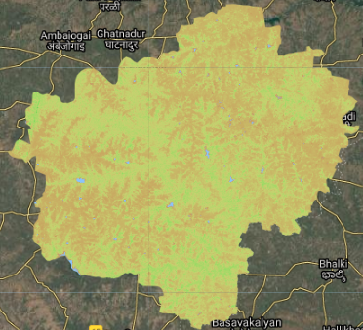
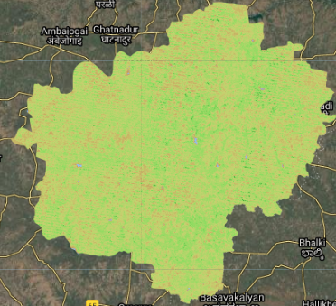
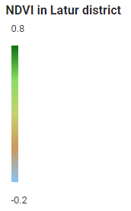
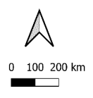
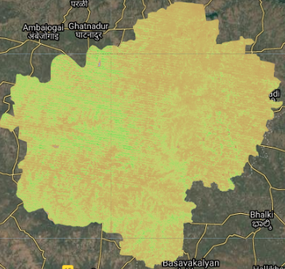
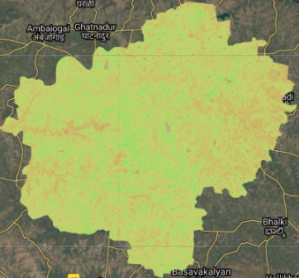
Latur district NDVI 2000
Latur district NDVI 2005
Latur district NDVI 2010
Latur district NDVI 2014

Slide 13
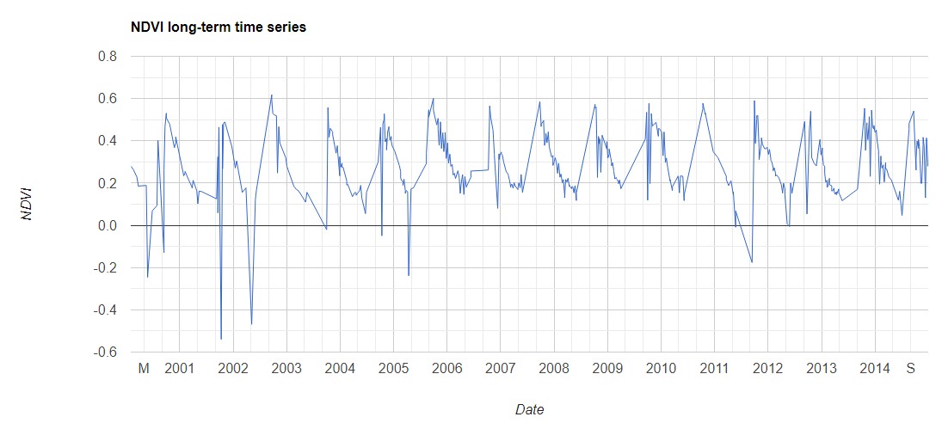
Temporal NDVI (2000-14)
Introduction
Model development
RS Data analysis
Model summary
Results and discussions
<0: Water
0.1: Bare land
> 0.1: Vegetation
Rouse, (1974)

Slide 14
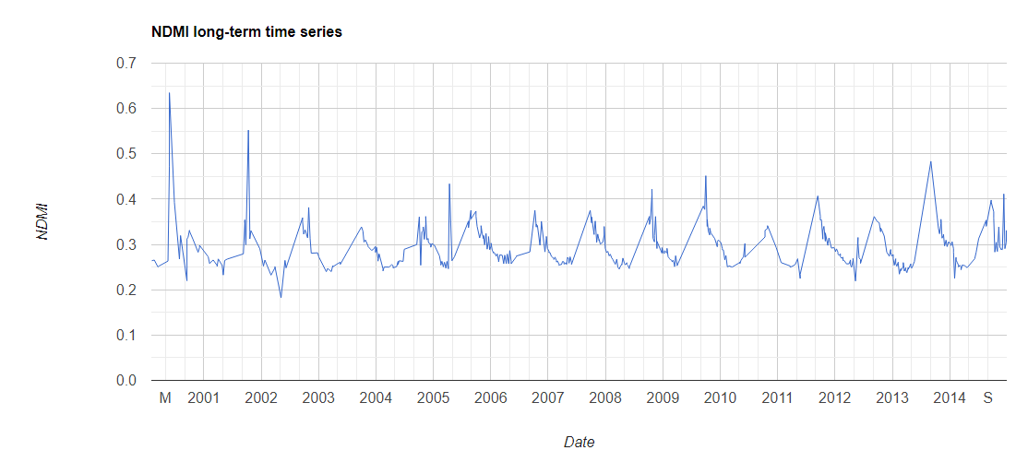
Temporal NDMI (2000-14)
Introduction
Model development
RS Data analysis
Model summary
Results and discussions
<0.2 : Extra dry
0.2 – 0.4: Dry
0.4 – 0.6 : Wet
>0.6 : Extreme wet
Wang and Qu, (2007)

Slide 15
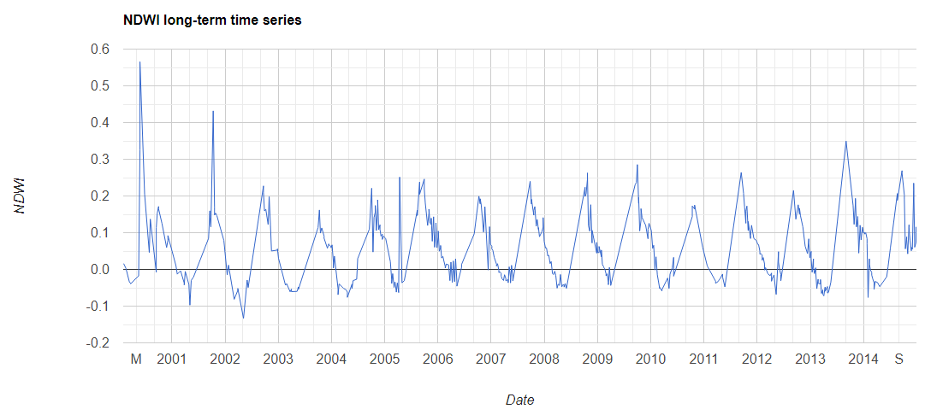
Temporal NDWI (2000-14)
Introduction
Model development
RS Data analysis
Model summary
Results and discussions
<0 : Drought conditions
>0 : Vegetation and soil moisture content
Gao, (1996)

Slide 16
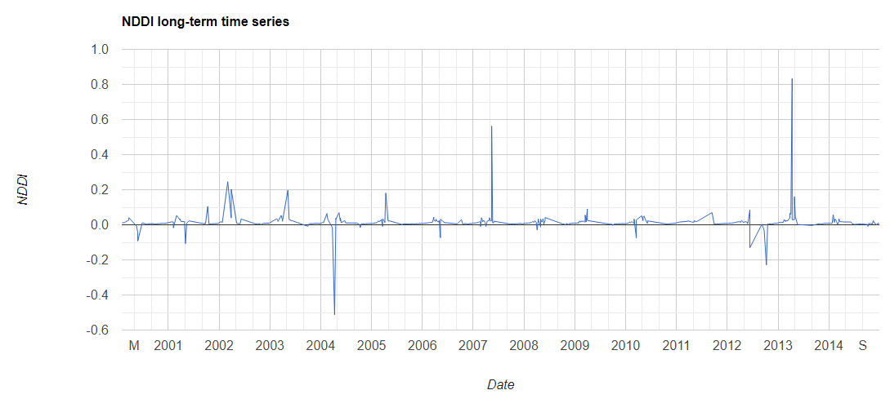
Temporal NDDI (2000-14)
Introduction
Model development
RS Data analysis
Model summary
Results and discussions
>0.5 : Extreme drought
0.3-0.5: Moderate drought
0.2-0.3 : Mild drought
-1 to 0.2 : No drought
Gu et al., (2007)

Slide 17
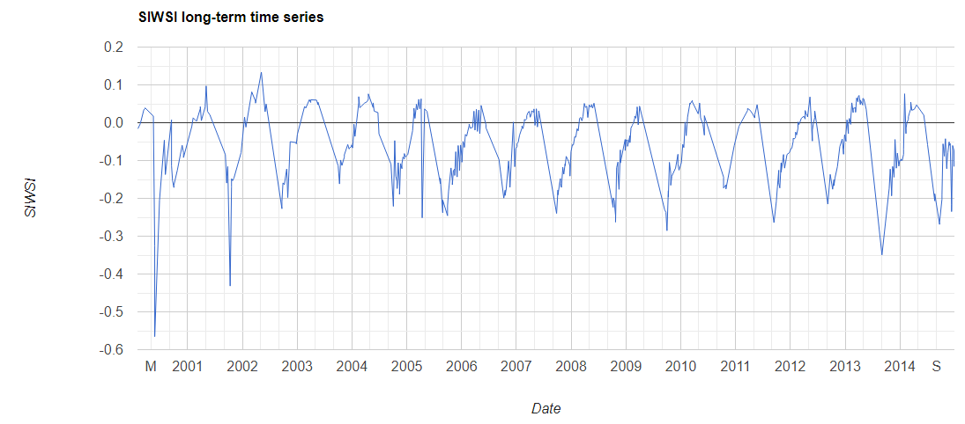
Temporal SIWSI (2000-14)
Introduction
Model development
RS Data analysis
Model summary
Results and discussions
>0 : Canopy water stress
Ceccato et al., (2001)

Slide 18
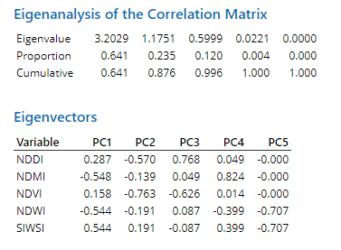
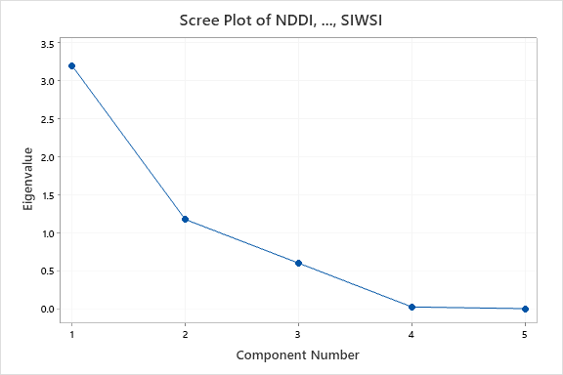
Preliminary Principal Component Analysis (5 Indices)
Introduction
Model development
RS Data analysis
Model summary
Results and discussions
Uncorrelated variables
Principle components

Slide 19
Preliminary RSEI Calculation (5 Indices)
Introduction
Model development
RS Data analysis
Model summary
Results and discussions
RSEI₅ = 1 – (PC1 + PC2 + PC3)
$$RSEI5=1 −PC(0.768∗NDDI−0.548∗NDMI−0.626∗NDVI−0.544∗NDWI+0.544∗SIWSI)$$
Normalizing the weights
$$RSEI5=1−PC(0.253∗NDDI−0.182∗NDMI−0.207∗NDVI−0.179∗NDWI+0.180∗SIWSI)$$
Higher the RSEI₅, better the ecological status of a region

Slide 20
Comparative analysis of RSEI₅
Introduction
Model development
RS Data analysis
Model summary
Results and discussions
Regression analysis
Area under crop in Latur district from 2000-14
Remote sensing indices - Landsat-7 ETM+
RSEI₅ shows strong positive correlation of 0.934 with area under crop
Sr. No. | Index | R-square
1 | NDVI | 83.35%
2 | NDWI | 76.29%
3 | NDMI | 62%
4 | NDDI | 74%
5 | SIWSI | 74.34%
6 | RSEI₅ | 87.22%

Slide 21
Comparative analysis of RSEI₅
Introduction
Model development
RS Data analysis
Model summary
Results and discussions
Regression analysis
Crop production in Latur district from 2000-14
Remote sensing indices - Landsat-7 ETM+
Newly developed RSEI₅ shows a strong positive correlation of 0.814 with crop production
Sr. No. | Index | R-square
1 | NDVI | 63.00%
2 | NDWI | 54%
3 | NDMI | 60.10%
4 | NDDI | 47%
5 | SIWSI | 52%
6 | RSEI₅ | 66.25%

Slide 22
Results and discussion
Introduction
Model development
RS Data analysis
Model summary
Results and discussions
Preliminary RSEI₅ shows strong positive correlation with crop area and production (0.934 and 0.814 res.)
RSEI accounts for holistic representation of land surface ecological status
Beta version (5 indices)
Full model with 22 indices (ongoing)

Slide 23
Future work
Introduction
Model development
RS Data analysis
Model summary
Results and discussions
Oct-Nov 2020
Dec
2020
Jan
2021
Feb 2021
Mar-Apr
2021
Mapping & Data Analysis using model
Secondary data analysis &
model validation
Web dashboard & Documentation
M&E of IWMP using RSEI
Model update
Weightage of indices
Developing remote sensing data pipeline
Secondary data analysis for model validation
M&E of IWMP projects
Dashboard design
Scaling model at Maharashtra level
Model update
Analyzing data using developed model
Model improvement
Protocol for using the M&E framework
Non Performing Areas

Slide 24
References
Behling, R., Bochow, M., Foerster, S., Roessner, S. and Kaufmann, H., 2015. Automated GIS-based derivation of urban ecological indicators using hyperspectral remote sensing and height information. Ecological Indicators, 48, pp.218-234.
Belgiu, M. and Csillik, O., 2018. Sentinel-2 cropland mapping using pixel-based and object-based time-weighted dynamic time warping analysis. Remote sensing of environment, 204, pp.509-523.
Ceccato, P., Flasse, S., Tarantola, S., Jacquemoud, S. and Grégoire, J.M., 2001. Detecting vegetation leaf water content using reflectance in the optical domain. Remote sensing of environment, 77(1), pp.22-33.
Friend, A. and Rapport D., 1979. Towards a comprehensive framework for environmental statistics: a stress-response approach. Statistics Canada 11-510, Ottawa, 1979.
Gao, B.C., 1996. NDWI—A normalized difference water index for remote sensing of vegetation liquid water from space. Remote sensing of environment, 58(3), pp.257-266.
Gou, R. and Zhao, J., 2020. Eco-Environmental Quality Monitoring in Beijing, China, Using an RSEI-Based Approach Combined With Random Forest Algorithms. IEEE Access, 8, pp.196657-196666.
Gu, Y., Brown, J.F., Verdin, J.P. and Wardlow, B., 2007. A five‐year analysis of MODIS NDVI and NDWI for grassland drought assessment over the central Great Plains of the United States. Geophysical research letters, 34(6), pp.1-6.
Hughey, K.F., Cullen, R., Kerr, G.N. and Cook, A.J., 2004. Application of the pressure–state–response framework to perceptions reporting of the state of the New Zealand environment. Journal of Environmental Management, 70(1), pp.85-93.
Hu, X., Hong, W., Qiu, R., Hong, T., Chen, C. and Wu, C., 2015. Geographic variations of ecosystem service intensity in Fuzhou City, China. Science of The Total Environment, 512, pp.215-226.
Jones, D.A., Hansen, A.J., Bly, K., Doherty, K., Verschuyl, J.P., Paugh, J.I., Carle, R. and Story, S.J., 2009. Monitoring land use and cover around parks: A conceptual approach. Remote sensing of environment, 113(7), pp.1346-1356.
Kennedy, R.E., Townsend, P.A., Gross, J.E., Cohen, W.B., Bolstad, P., Wang, Y.Q. and Adams, P., 2009. Remote sensing change detection tools for natural resource managers: Understanding concepts and tradeoffs in the design of landscape monitoring projects. Remote sensing of environment, 113(7), pp.1382-1396.
Liao, W. and Jiang, W., 2020. Evaluation of the Spatiotemporal Variations in the Eco-environmental Quality in China Based on the Remote Sensing Ecological Index. Remote Sensing, 12(15), p.2462.
Nguyen, M.D., Baez-Villanueva, O.M., Bui, D.D., Nguyen, P.T. and Ribbe, L., 2020. Harmonization of Landsat and Sentinel 2 for Crop Monitoring in Drought Prone Areas: Case Studies of Ninh Thuan (Vietnam) and Bekaa (Lebanon). Remote Sensing, 12(2), p.281.
Wang, L. and Qu, J.J., 2007. NMDI: A normalized multi‐band drought index for monitoring soil and vegetation moisture with satellite remote sensing. Geophysical Research Letters, 34(20), pp.1-5.
Willis, K.S., 2015. Remote sensing change detection for ecological monitoring in United States protected areas. Biological Conservation, 182, pp.233-242.
Xu, H., 2013. A remote sensing index for assessment of regional ecological changes. China Environmental Science, 33(5), pp.889-897.
Xu, H., Wang, M., Shi, T., Guan, H., Fang, C. and Lin, Z., 2018. Prediction of ecological effects of potential population and impervious surface increases using a remote sensing based ecological index (RSEI). Ecological indicators, 93, pp.730-740.
Xu, H., Wang, Y., Guan, H., Shi, T. and Hu, X., 2019. Detecting Ecological Changes with a Remote Sensing Based Ecological Index (RSEI) Produced Time Series and Change Vector Analysis. Remote Sensing, 11(20), p.2345.

Slide 25
Softwares / tools used
Google Earth Engine
Python API
JavaScript API
Python for Data Analysis

Slide 26
Thank you !!!

Slide 27
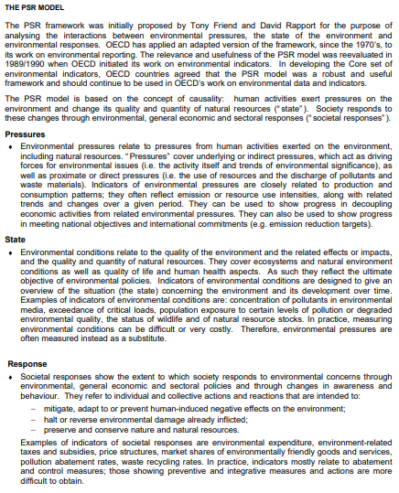
PSR Framework

Slide 28
Crops in Latur
Sr. No. | Season | Crop
1 | Khariff | Bajra, Cotton, Jowar, Groundnut, Maize, Green gram, Soybean, Sunflower
2 | Rabi | Wheat, Urad, Gram, Linseed, Mustard
3 | Summer | Sunflower, Groundnut
4 | Whole year | Sugarcane

Slide 29
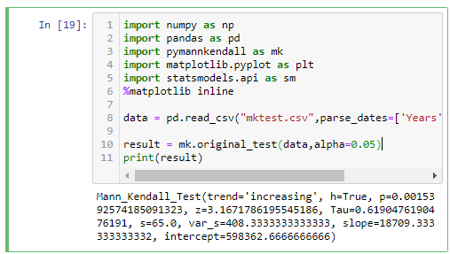
Mann Kendall test
Introduction
Model development
RS Data analysis
Model summary
Results and discussions
Mann-Kendall Trend Test (MK test) is used to analyze time series data
H0: There is no trend in data
H1: There is trend in the (Upward or downward)
pyMannKendall 1.4.1 library in Python
Increasing trend (with p-value: 0.00153)

Slide 30
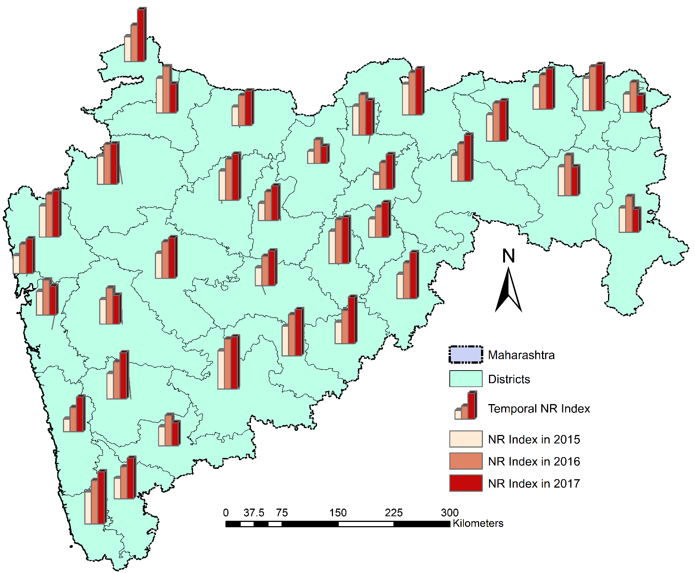
Illustrative prototype
Need to see district wise statistics
But here one glance view
No need to see 36 districts and taluks reports
Spatial idea of where does a shoe pinch
No need to wait till the annual report arrives but near real time
Plan for immediate intervention

Slide 31
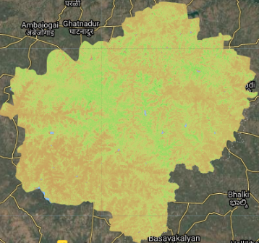
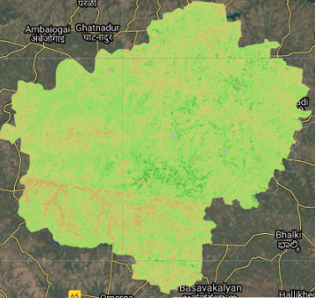
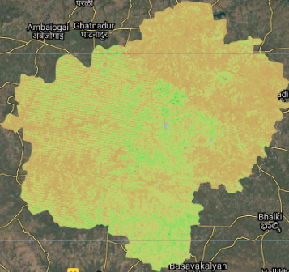
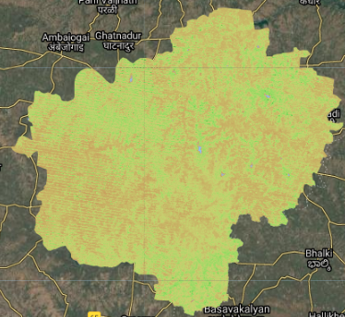
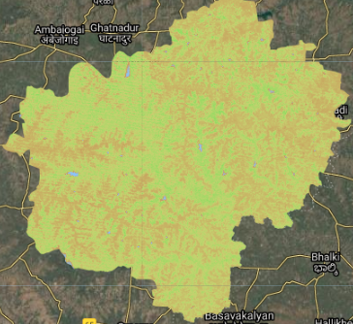
Latur district NDVI 2000
Latur district NDVI 2001
Latur district NDVI 2002
Latur district NDVI 2003
Latur district NDVI 2003
Latur district NDVI 2004
Latur district NDVI 2005
Latur district NDVI 2006

Slide 32
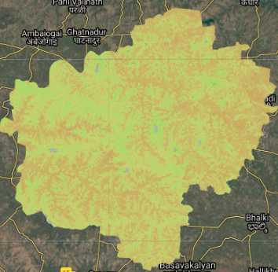
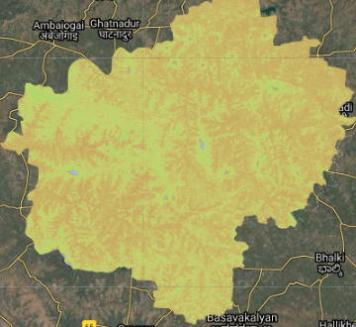
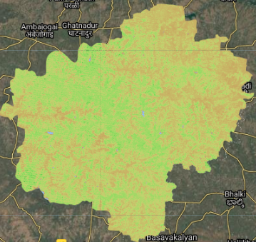
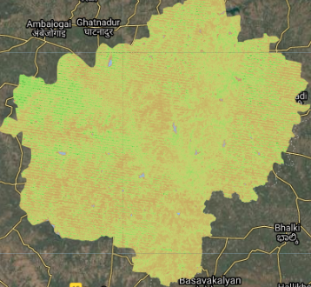
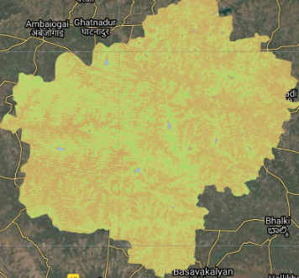
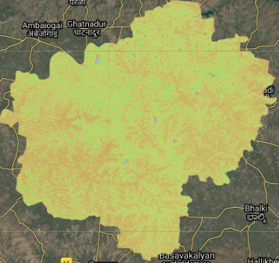
Latur district NDVI 2007
Latur district NDVI 2008
Latur district NDVI 2009
Latur district NDVI 2010
Latur district NDVI 2011
Latur district NDVI 2012
Latur district NDVI 2013
Latur district NDVI 2014

Slide 33
EIGENVALUES:
The eigenvalue is a measure of how much of the variance of the observed variables a factor explains.

Slide 34
Conversions of agricultural lands
Total agricultural land vs area under cultivation
How much fallow land changed to cultivation

